Slide 1
chem

Slide 2
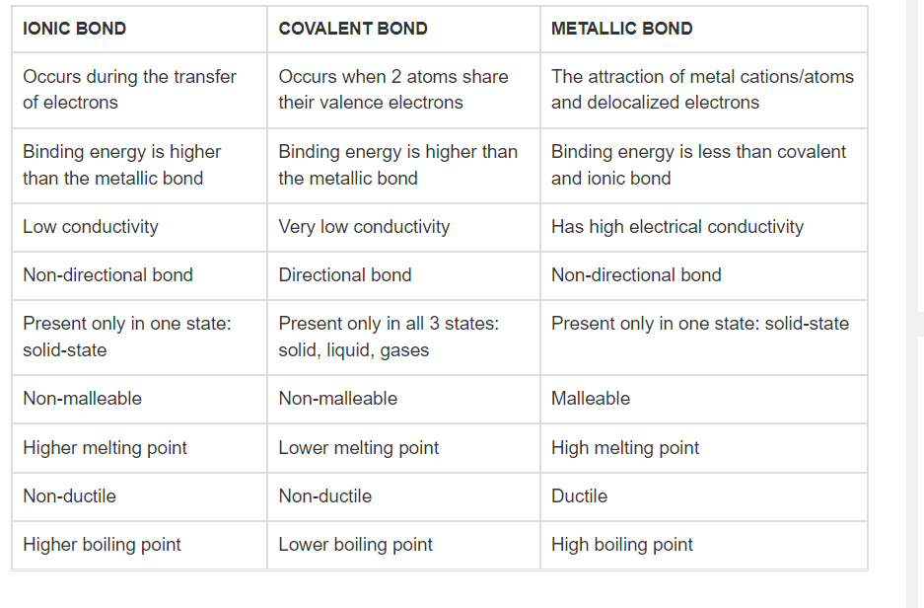

Slide 3
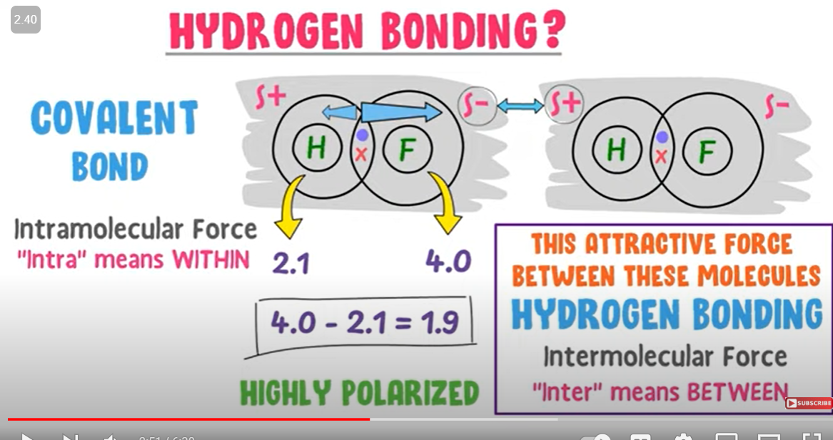

Slide 4
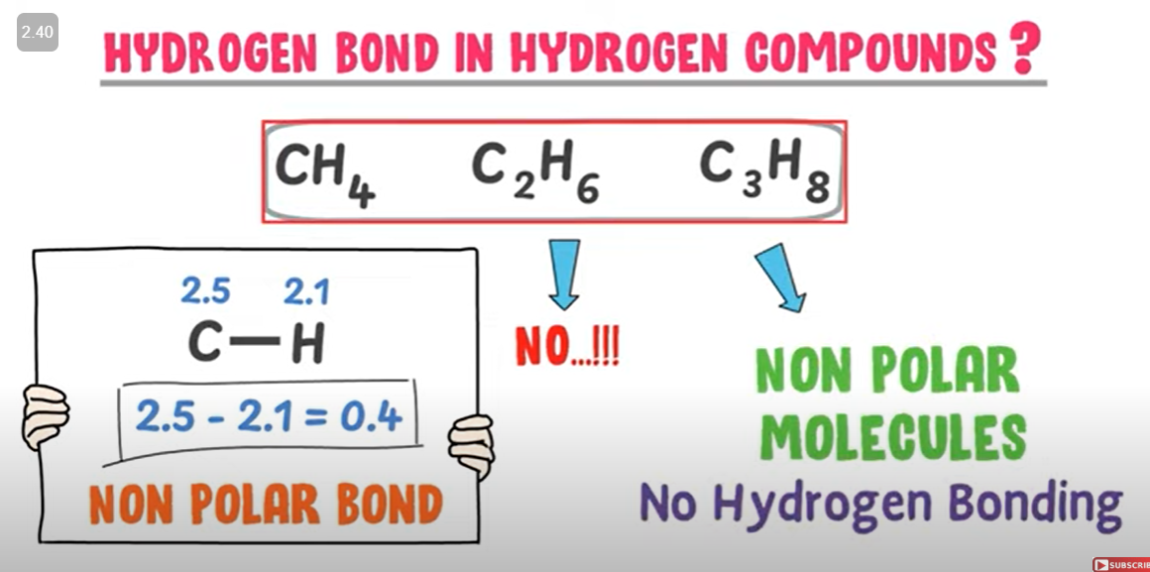

Slide 5
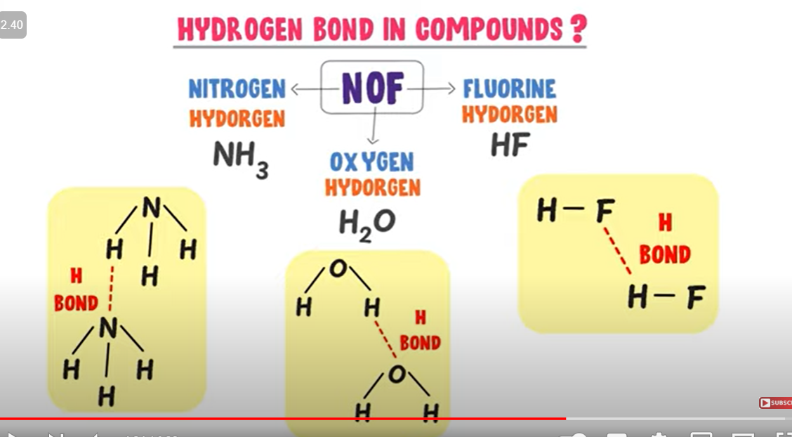

Slide 6
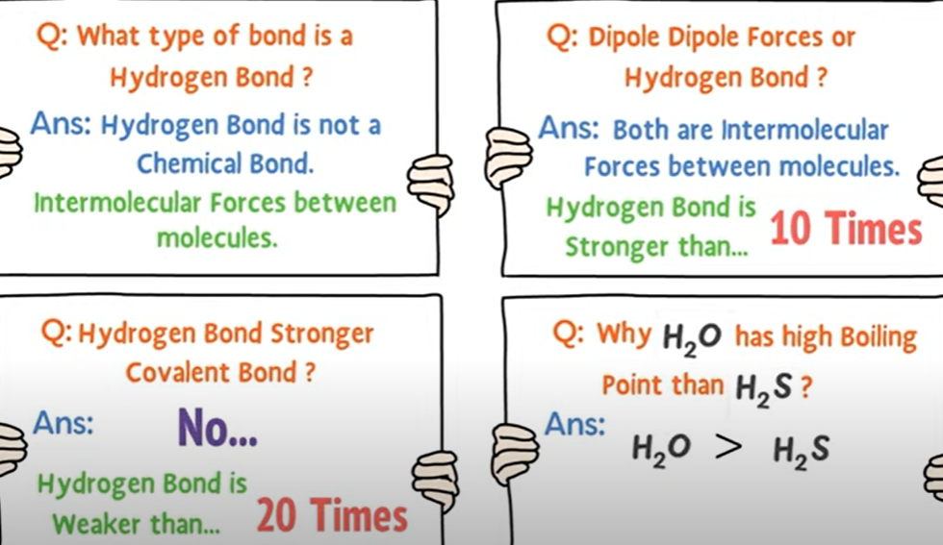

Slide 7
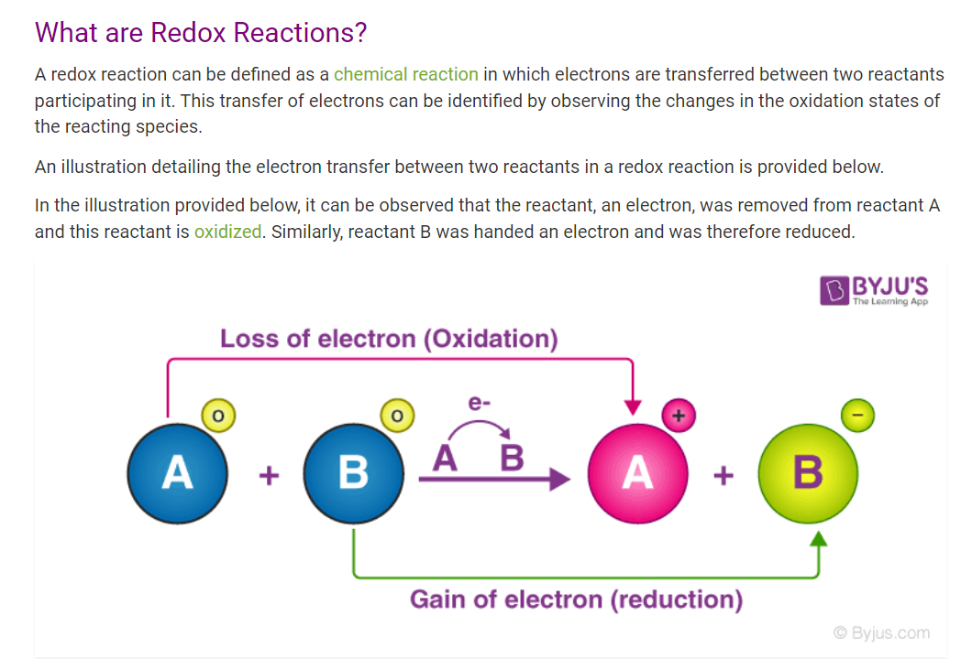

Slide 8
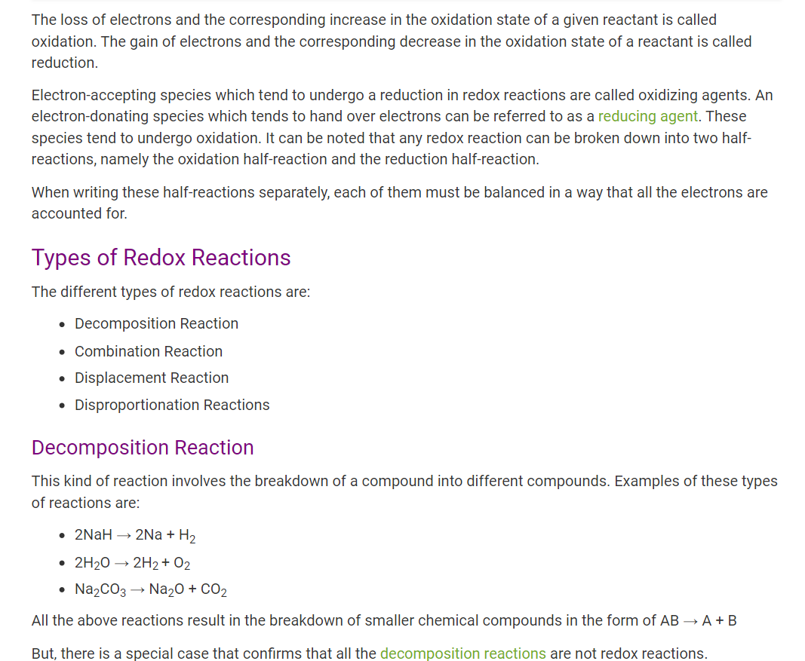

Slide 9
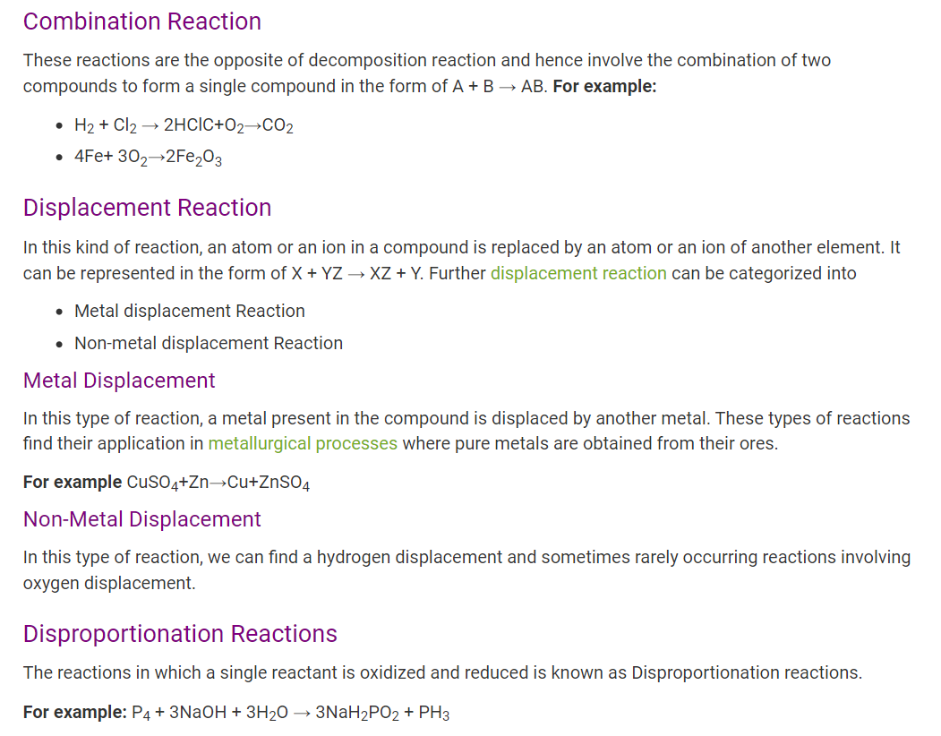

Slide 10
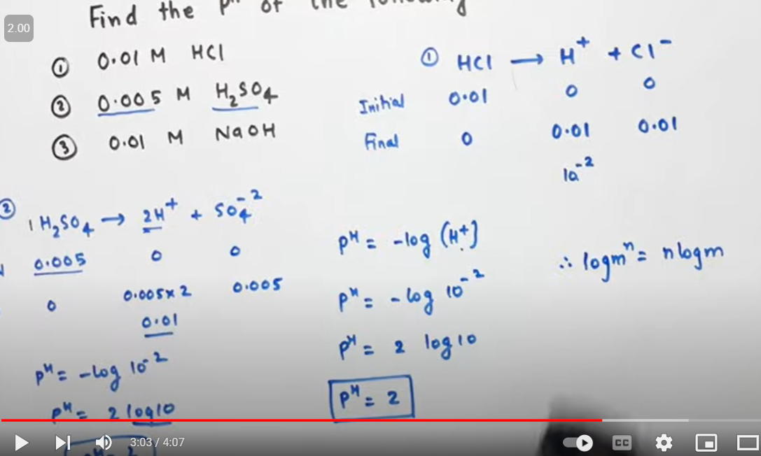

Slide 11
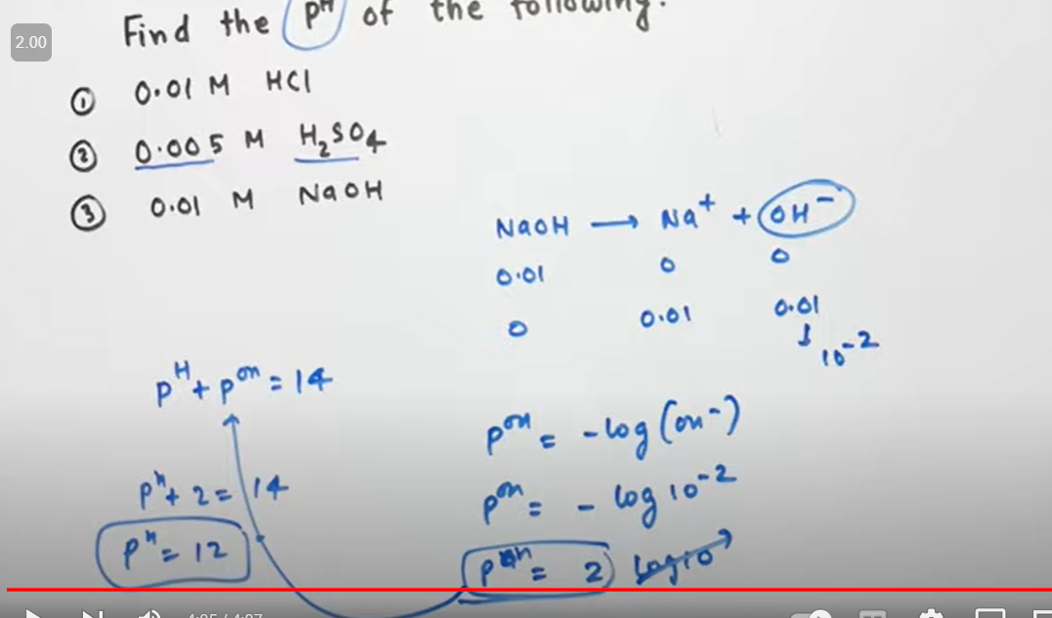

Slide 12
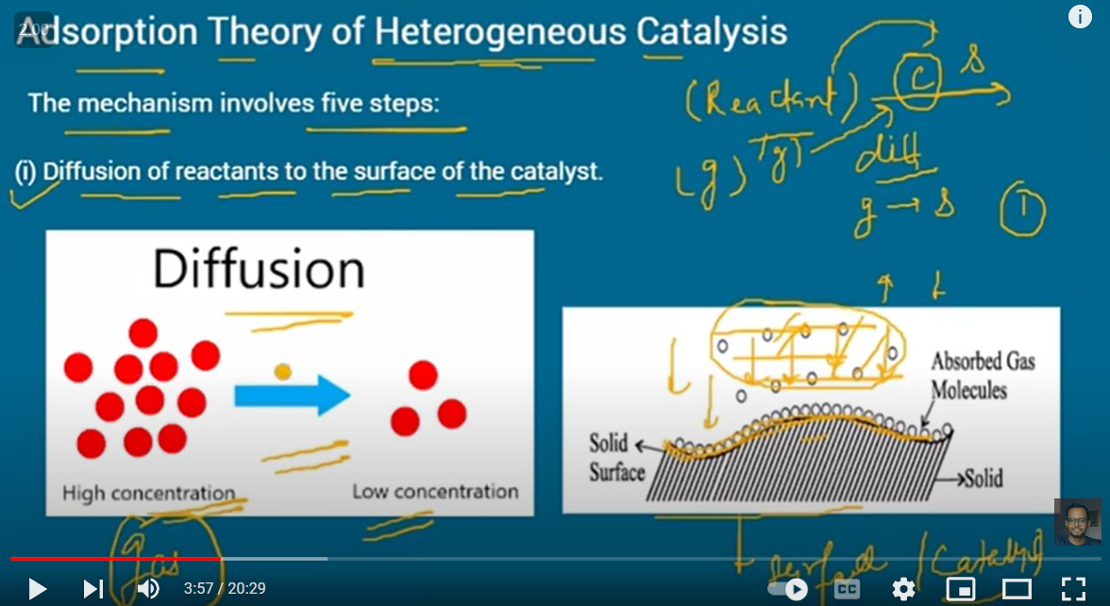

Slide 13
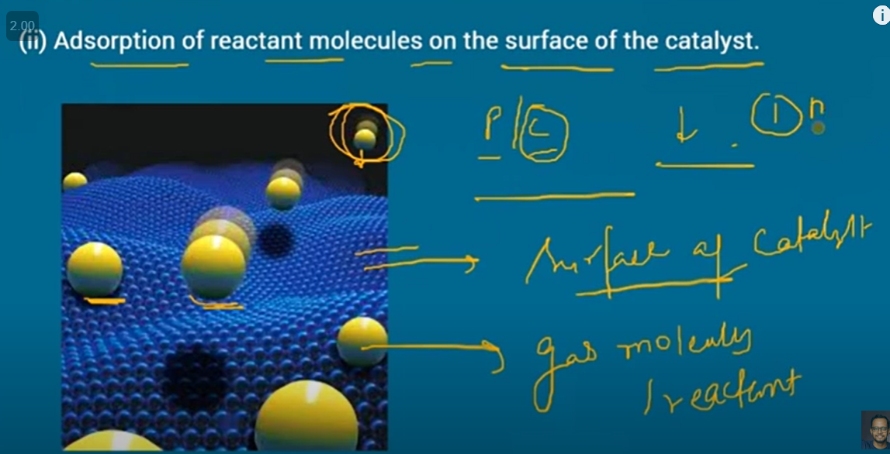

Slide 14
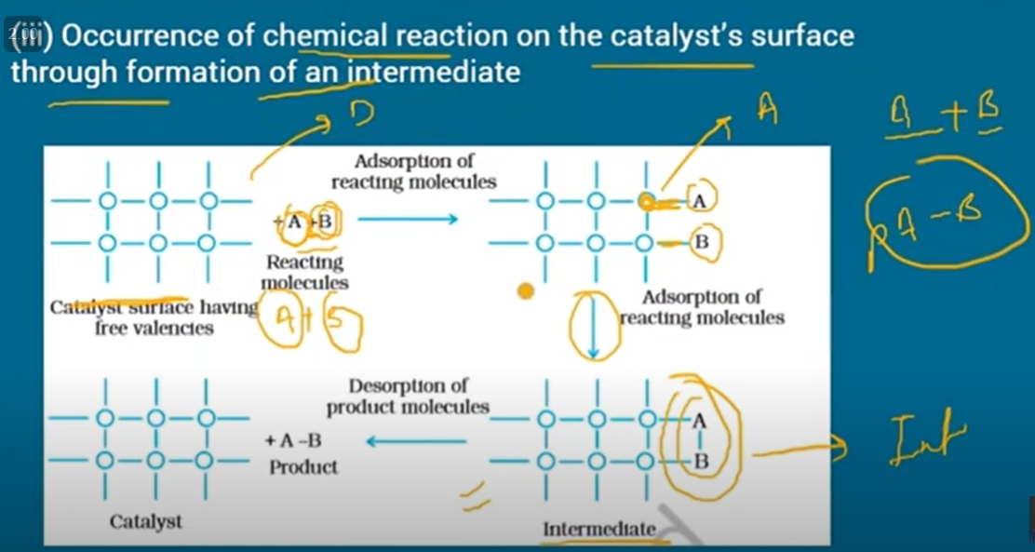

Slide 15
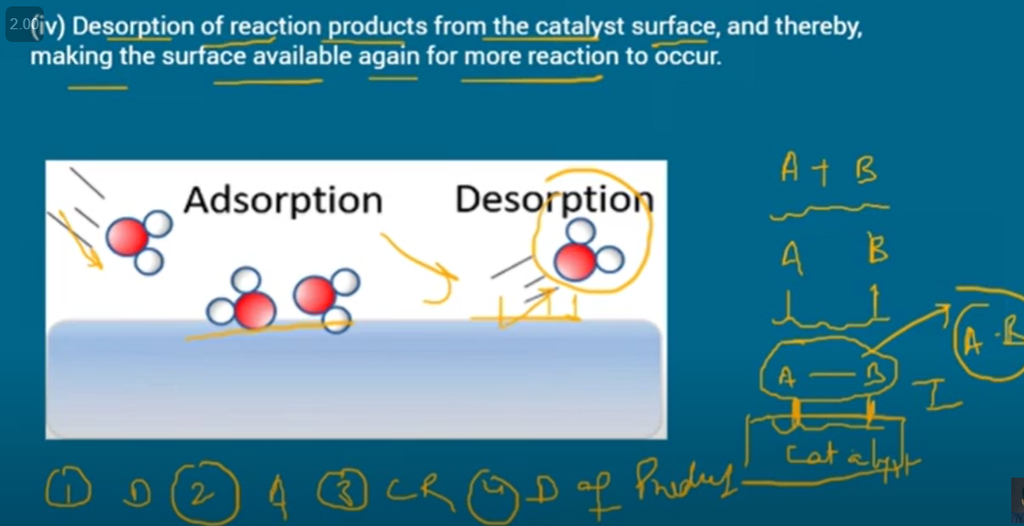

Slide 16
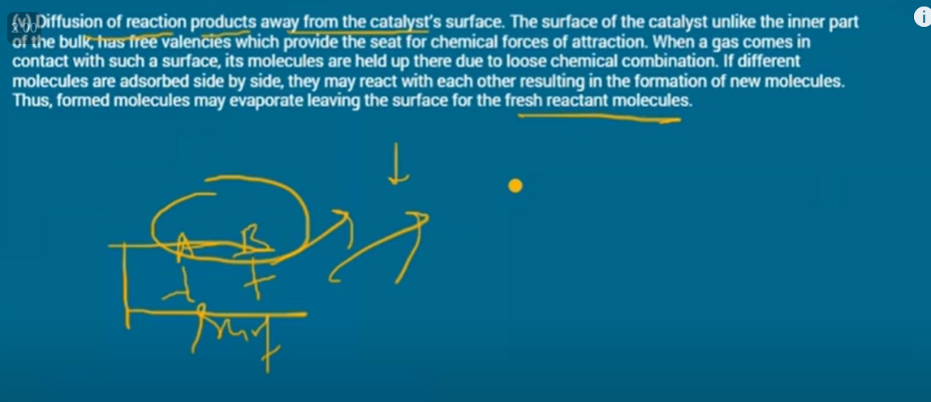

Slide 17
Boiling point of H2O is higher than that of HF. Explain why?
Both H2​O and HF have electronegative oxygen and fluorine atoms respectively in their molecule. In fact, Fluorine is more electronegative than Oxygen, so technically, HF should engage in more hydrogen bonding than water. But the scenario is different.
Each water molecule has two hydrogen atoms. Whereas, each HF molecule has only one hydrogen atom. And hence, water molecule takes part in extensive and more hydrogen bonding than Hydrofluoric acid. Water molecule through its extensive hydrogen bonding forms a bulky molecule and it is very difficult to break its bonds. A large amount of energy is required to break all its bonds. Thus H2​O has a higher boiling point than HF.

Slide 18
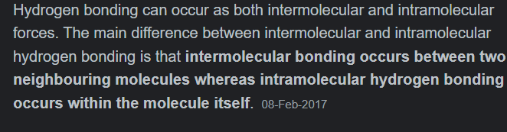
2. Why o-nitrophenol is volatile in steam but p-nitrophenol is not?
O-Nitrophenol forms intramolecular H bond whereas molecules of P-Nitrophenol get associated through intermolecular H bond. During boiling, the strong intermolecular H bonding increases the boiling point but intramolecular H bonding cannot do so. Therefore, O-Nitrophenol is more steam volatile than P-Nitrophenol.

Slide 19
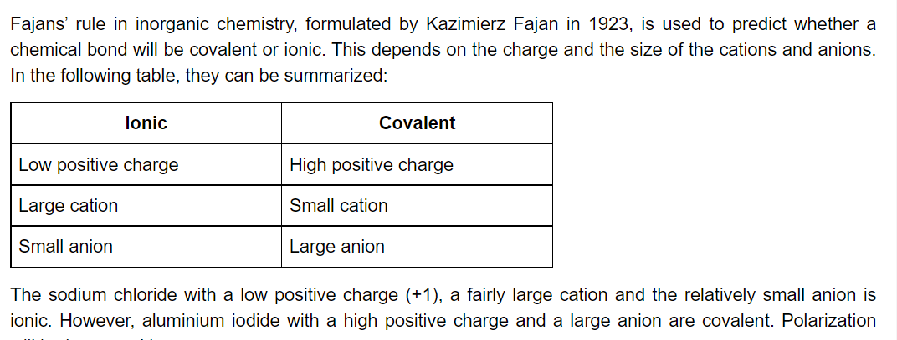
3. Why is glycerol more viscous than ethanol?
Glycerol is more viscous than ethane because of the expensive hydrogen bonding in glycerol. Alcohol also exhibit hydrogen bonding but glycerol contains three on per molecule and alcohol has only are OH group that can exhibit H−bonding.
Why cane sugar (sucrose) melts on heating but common salt (sodium chloride) does not melt easily?
Common salt (NaCl) is an ionic compound in which `Na^(+)` ions and `Cl^(-)` ions are held together by strong electrostatic forces of attraction. Hence, its melting point is very high. Sucrose is a covalent compound and no ions are present.
5. Generally, solids sink into water but ice floats on water. Explain why?
Solution : Ice floats on water because it has lower densit than water. The reason for lower density is that in ice, `H_(2)O` molecules are linked together through hydrogen bonds leaving large vacant spaces inbetween giving it a cage-like structure which occupies large volume.27-Jun-2022

Slide 20
